Slide 1
Experimented with: number of axes, placement of axes, line coloring (cost-based vs size-based)
(I have also tried using discrete values rather than percentile but have decided against using this) Patient Experience and Cost correlate (neg. relationship) but no other variables have notable correlation
FOUR axes:
Size as first axis:
p. 2 - size-based coloring p. 3 – cost coloring
Cost as first axis:
p. 4 – cost coloring
THREE axes:
Size as first axis:
p.5 – size coloring
p.6 – cost coloring
Cost as first axis:
p.7– cost coloring

Slide 2
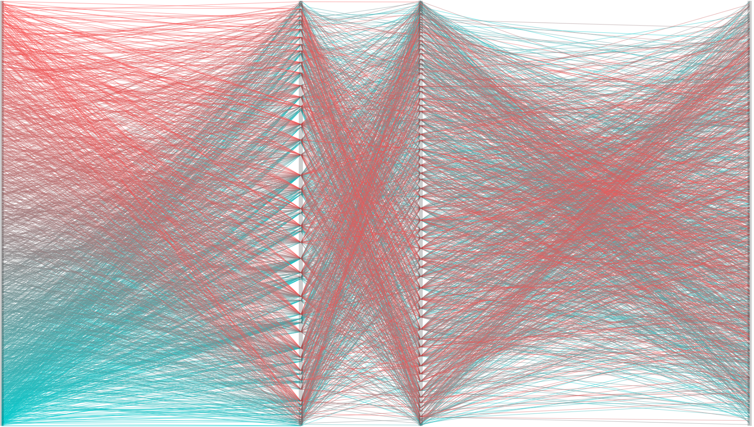
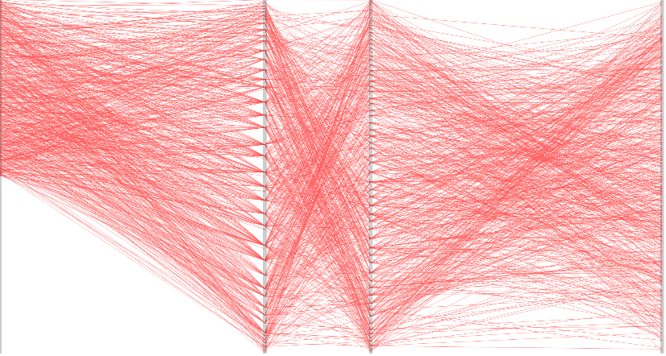
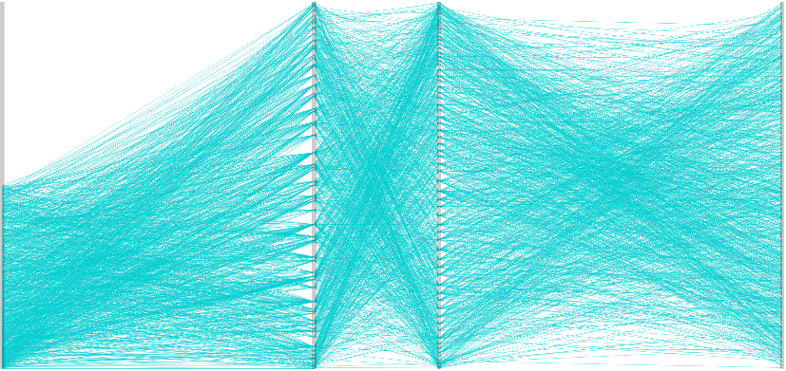
SIZE
outcome
patient experience
COST
high
low

Slide 3
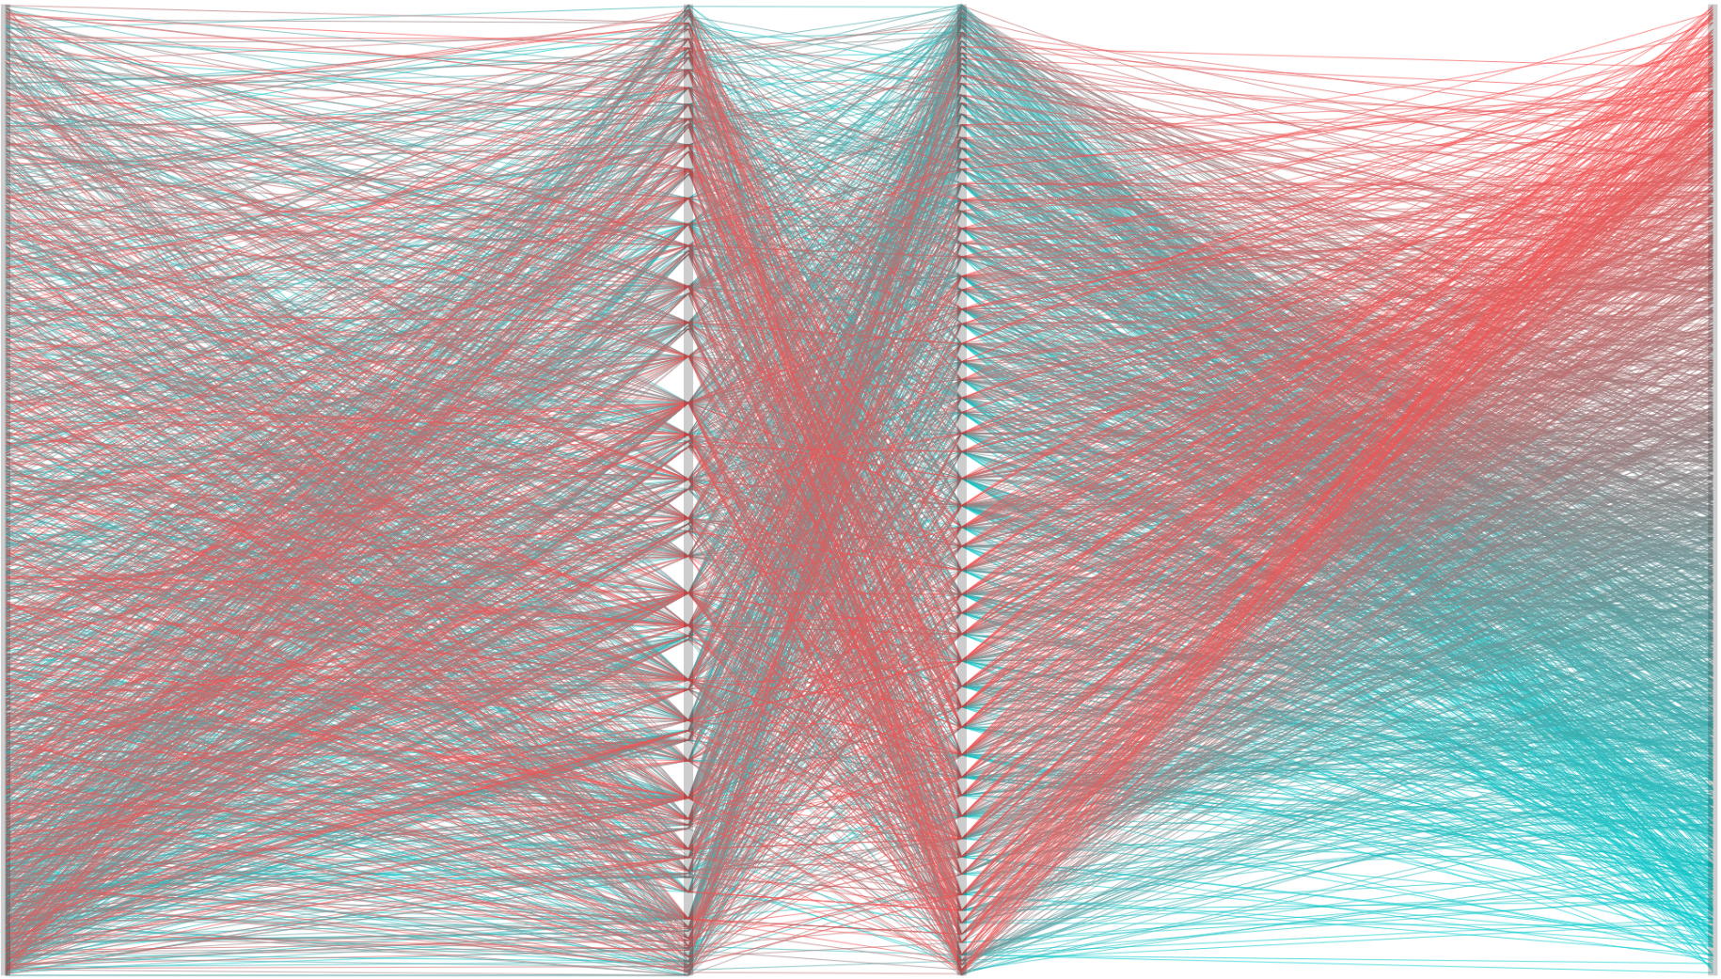
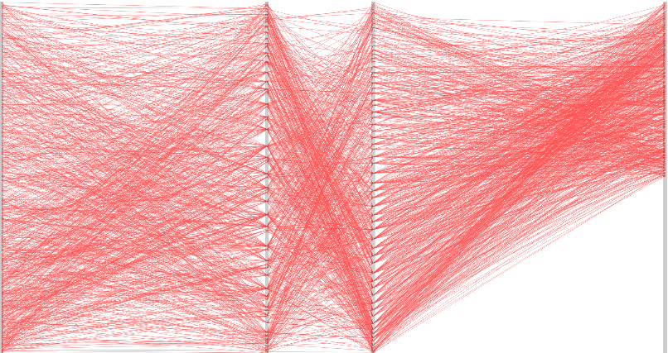
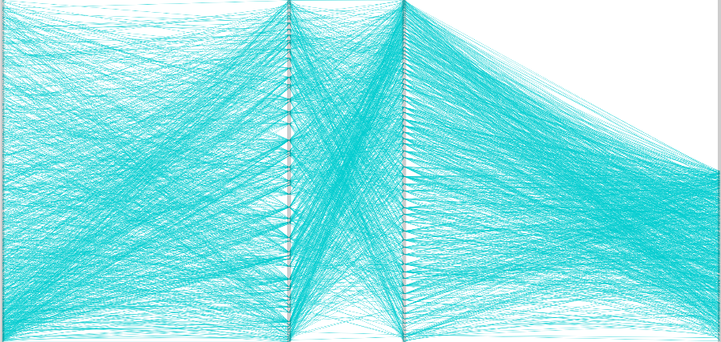
SIZE
outcome
patient exp
COST
high
low

Slide 4
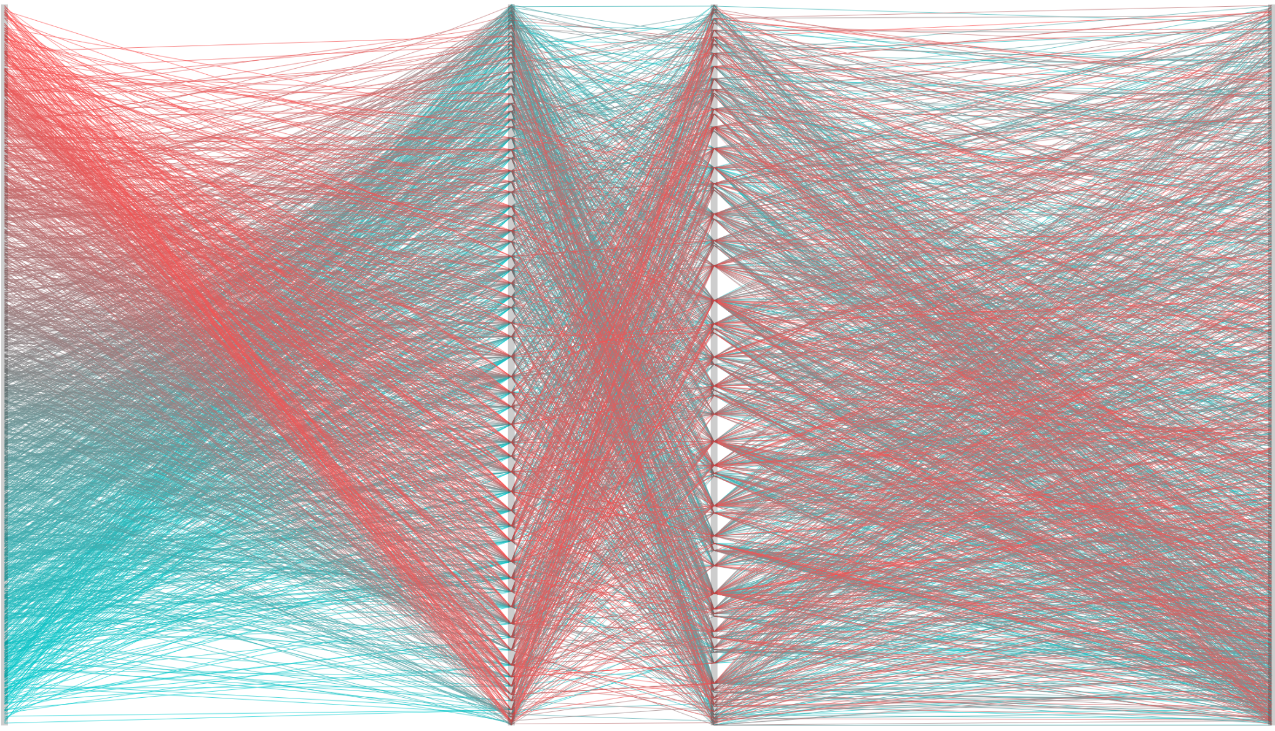
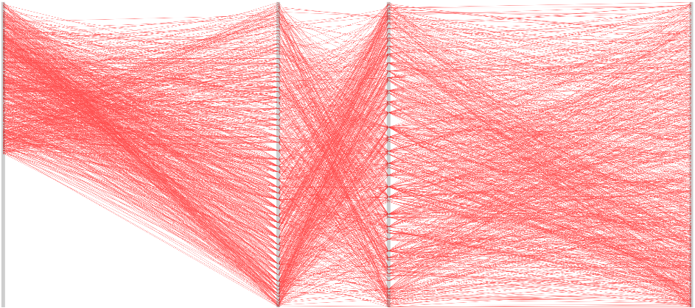
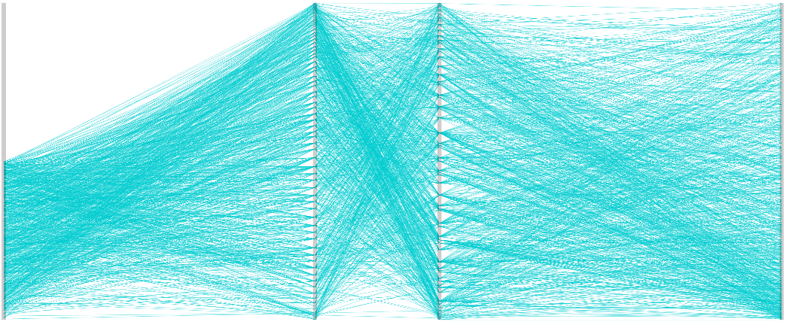
COST
patient exp
outcome
SIZE
high
low

Slide 5
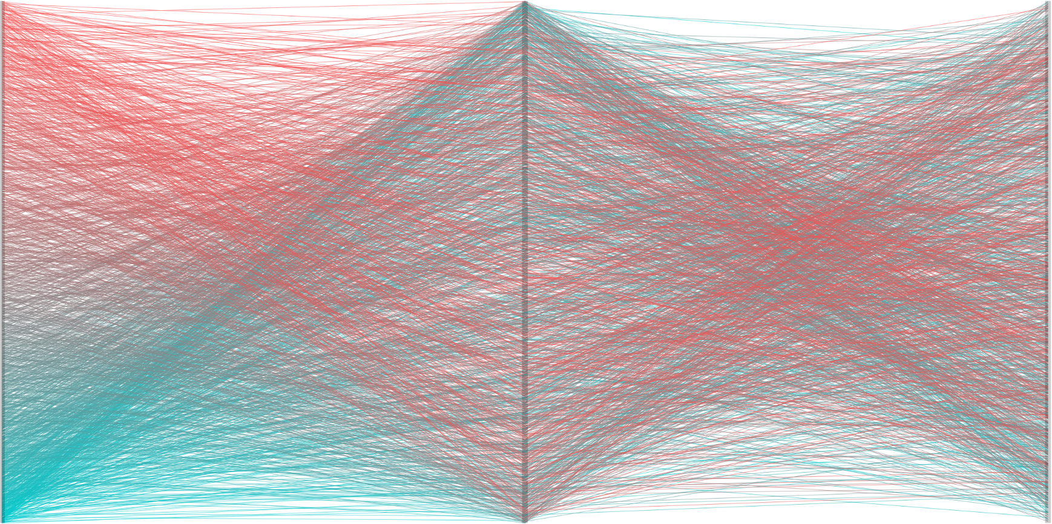
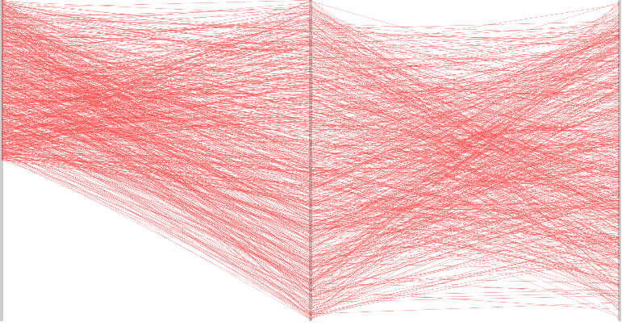
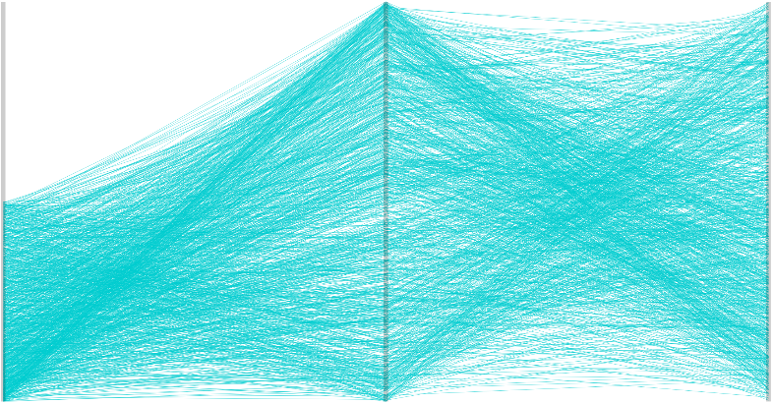
SIZE
QUALITY
COST
high
low

Slide 6
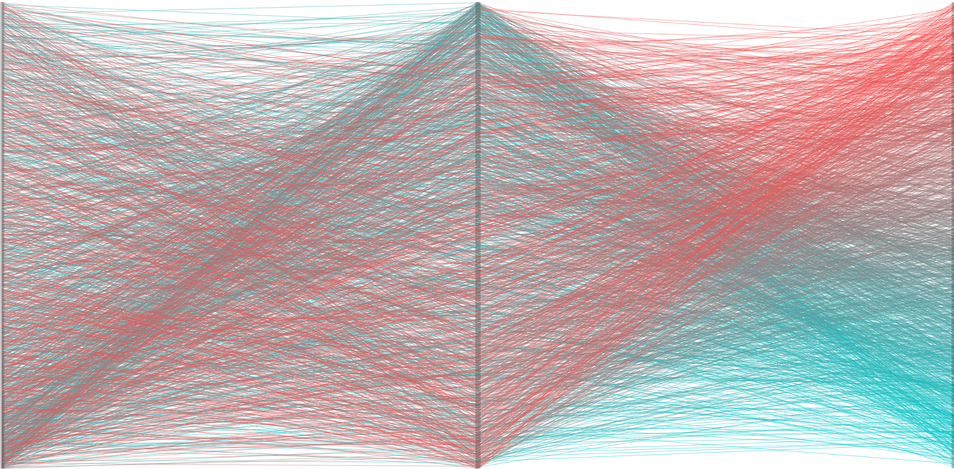
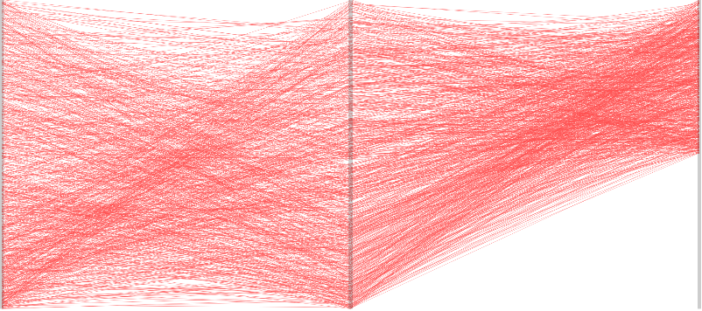

SIZE
QUALITY
COST
high
low

Slide 7
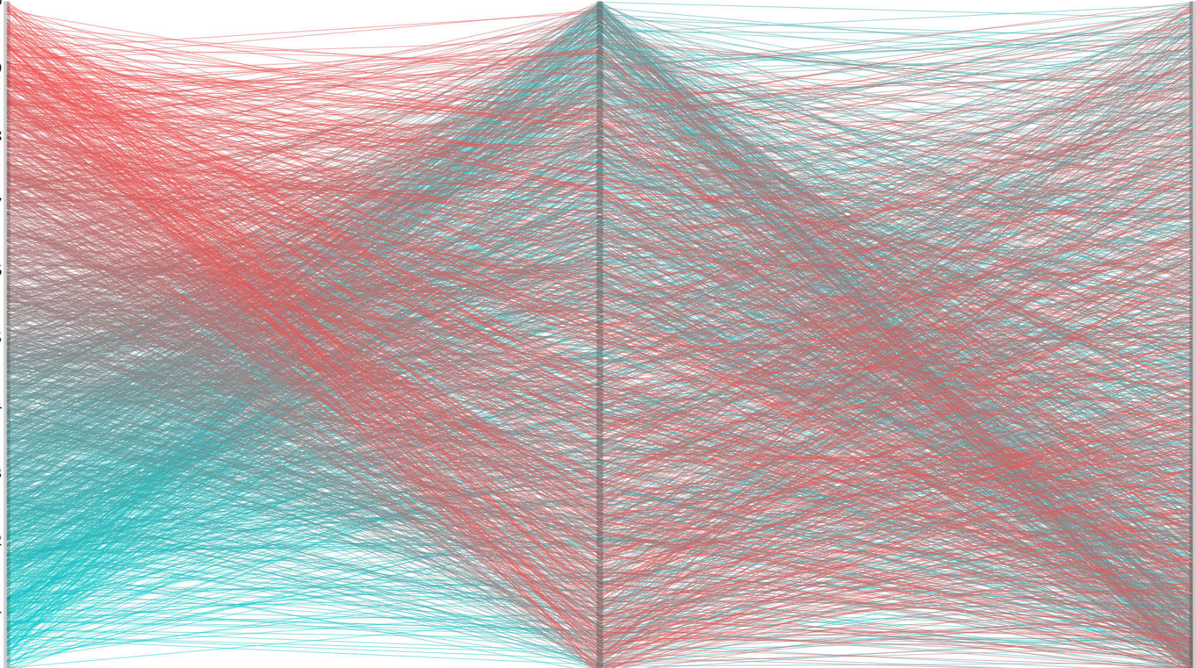
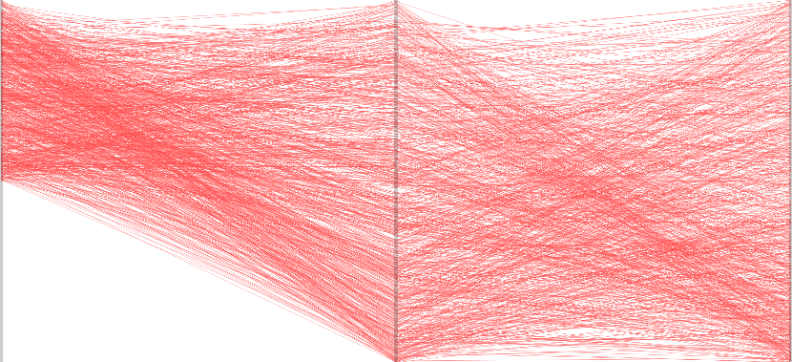

COST
QUALITY
SIZE
high
low

